Slide 1
C1-1 CHARACTERISTICS OF AN ECOSYSTEM
Mr. Ratliff

Slide 2
A. Life on Earth
Environment—surroundings in which an organism lives
Biotic—living things in all 5 kingdoms in an environment

Slide 3
Abiotic—nonliving things in the environment —includes soil, minerals, air, water, rocks, sunlight, rainfall, clouds, temperature, humidity—abiotic factors determine what can live in an environment.

Slide 4
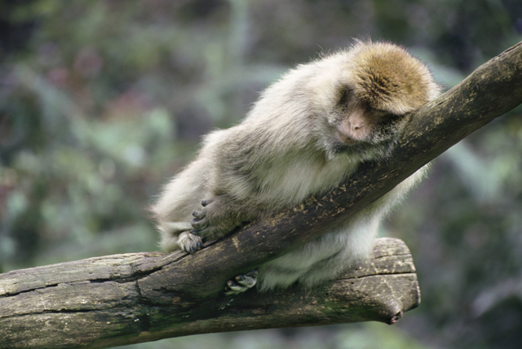
B. Organisms in an Ecosystem
Habitat—the part of an environment in which an organism lives
Population—organisms of the same species living together in the same environment

Slide 5
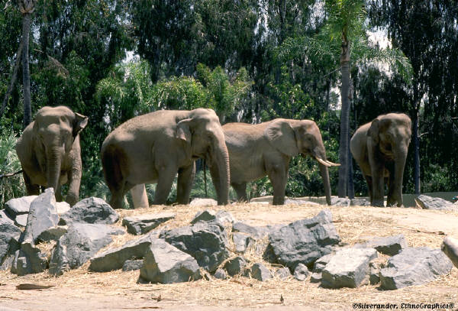
Community—all populations living in the same area at the same time
Ecosystem—made up of the community and all the abiotic parts of an environment

Slide 6
C. How Abiotic Factors Affect Ecosystems
--abiotic factors determine the kinds of plants and animals that live in an ecosystem
--climate is a major factor in what organisms can live in an ecosystem
--where there are more plants, there are more animals

Slide 7
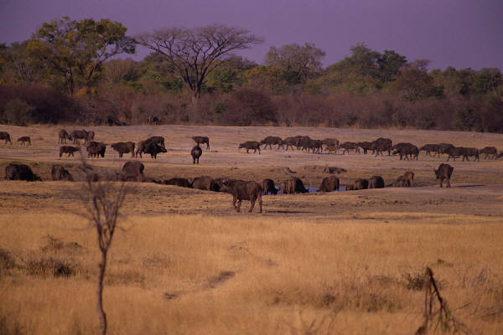
--warm, wet environments support the most life
Niche—role of an organism in its environment
--populations in the same habitat usually have different niches so they won’t compete for resources (food)

Slide 8
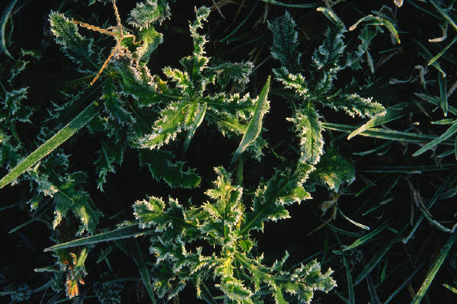
D. How Biotic Factors Affect Ecosystems
--the presence of one population depends on what other population are there—organisms will be there if their food supply is there
--first organisms to come back after fire or flood destroys an ecosystem are small, weedy plants
--as plants grow, animals and other organisms begin to appear

