Slide 1
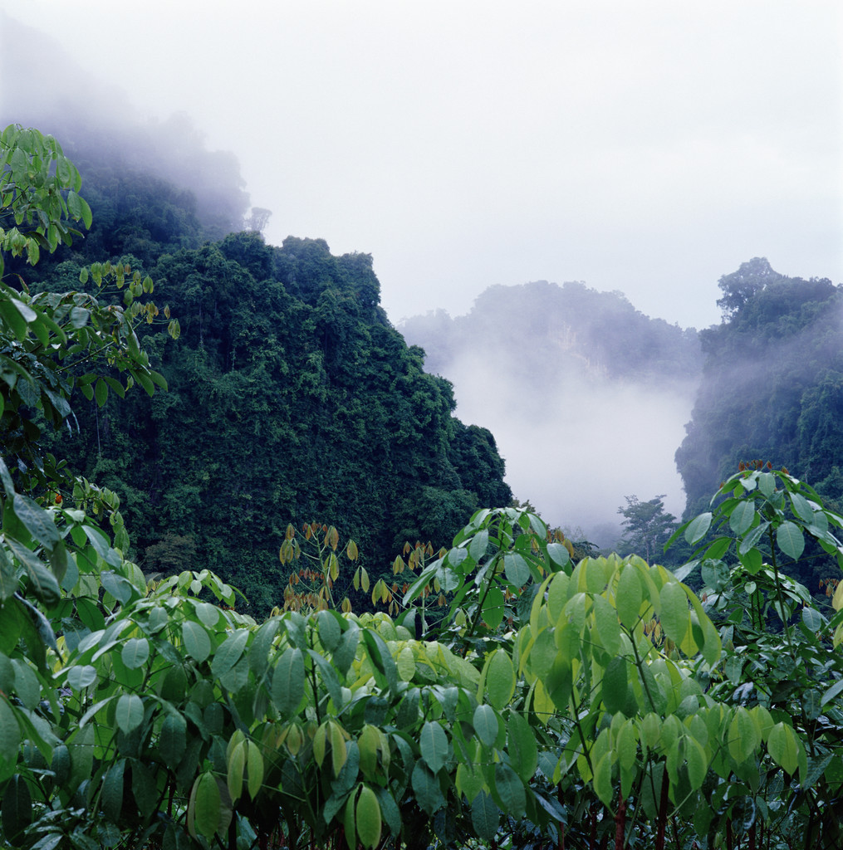
C 1-3 HOW PEOPLE USE NATURAL RESOURCES

Slide 2

A. Renewable Resources
Reusable resources—resources that can be used again and again—i.e. water, CO2, O2, N2—reused in cycles
  Recycling makes things reusable

Slide 3
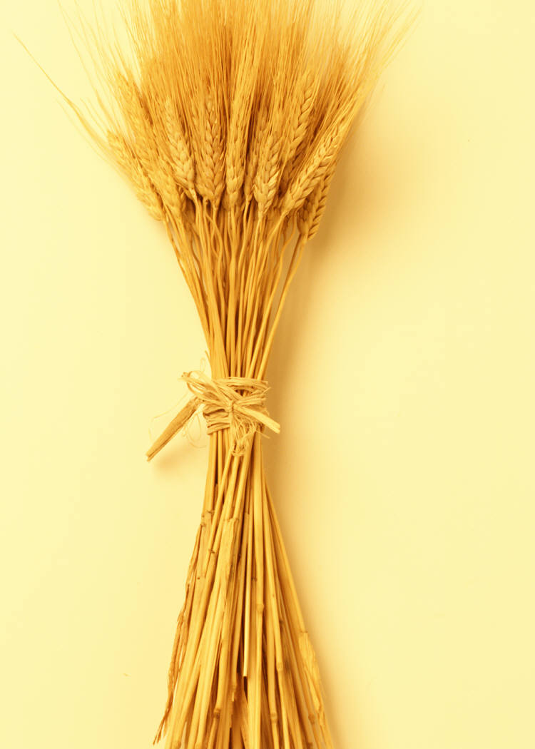
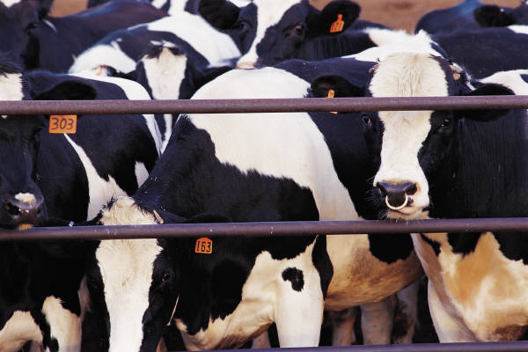
Renewable resources—resources that can be replaced within a human life span—i.e. wood, plants or crops, herd of cattle

Slide 4
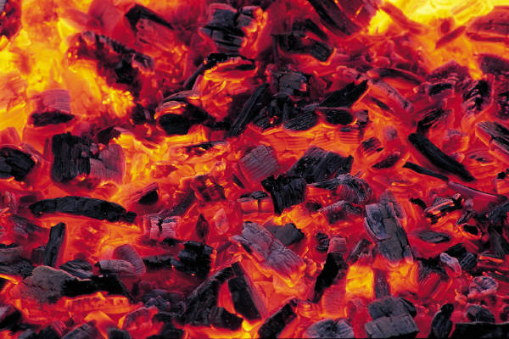
B. Nonrenewable resources
Nonrenewable resources—resources that cannot be replaced within a human life span—i.e. coal, fossil fuels, oil, old-growth forest, groundwater may be, topsoil is being lost to erosion by wind and water, minerals

Slide 5
C. Humans Can Alter Ecosystems
Resources obtained through mining, agriculture and forestry change the ecosystems
Human activity can cause water shortages, pollution
Reducing human effect on the environment happens when we conserve resources

Slide 6
Conservation—saving of resources—prevents damage and using up of resources
    Ways to conserve include—
      Use less—turn off lights, energy efficient appliances, modern cars have better gas mileage, carpool, use public transportation

Slide 7
SAVING ENERGY SAVES EVEN MORE ENERGY—don’t need as many resources to mine, transport and process natural resources
      Recycle—aluminum, glass, plastic, iron, steel
      Using a substitute resource—use hydroelectric energy, wind energy, solar energy, wave energy, geothermal energy—save fossil fuels and cause very little pollution

Slide 8
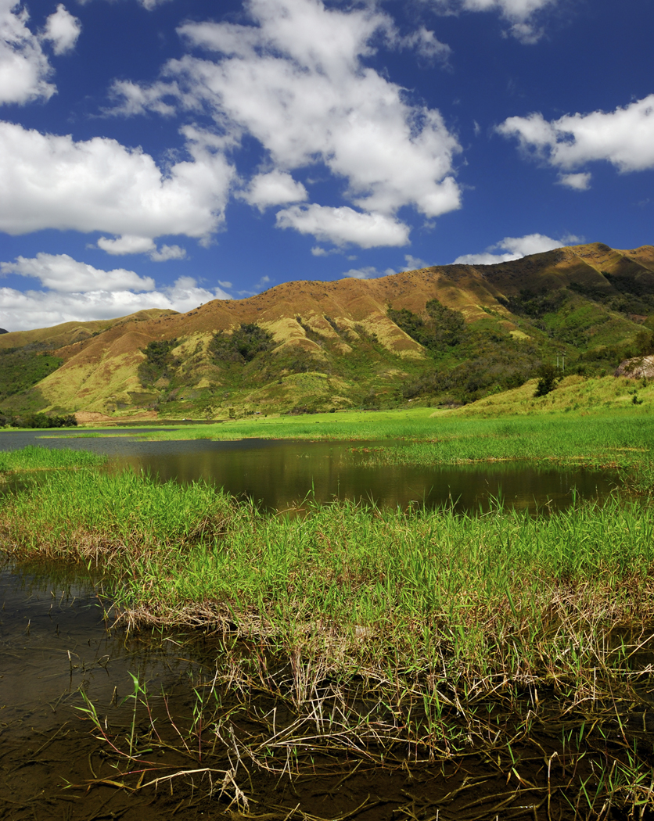
Preservation—when land is set aside to protect resources, plants and animals from hunting and other harmful activities

Slide 9
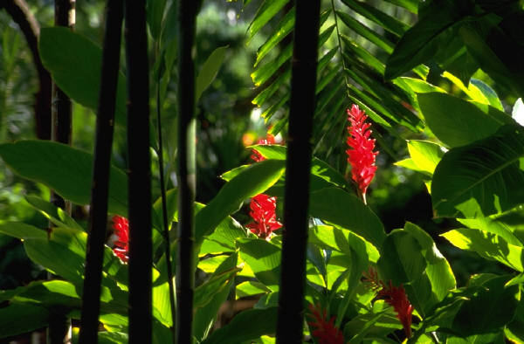
D. Problems and solutions
Overgrazing causes more land to become desert
Introducing harmful organisms without natural predators
Solutions to some—metal structures in coral reef provide more habitat
    Using plants from rainforest may help fight disease

