Slide 1
F-2 SPEED AND VELOCITY
Mr. Ratliff

Slide 2
A. OBSERVING MOTION
Change in an object’s position compared to objects that are still
Distance divided by time equals speed

Slide 3

B. IDENTIFYING FRAME OF REFERENCE
Frame of reference is something you don’t expect to move—helps observe and measure motion

Slide 4
C. CALCULATING SPEED
Speed—measure of how far something moves during a period of time
Measure of average speed is more useful
Average speed—measure of total distance divided by total elapsed time

Slide 5
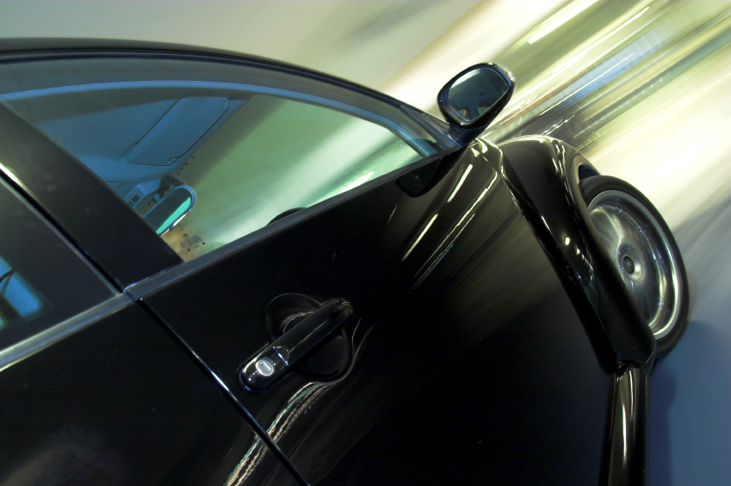
D. VELOCITY
Velocity—speed of an object in a particular direction
Moving along a curve, velocity changes constantly even if speed is the same

Slide 6
E. LAWS OF MOTION
Newton built on ideas of Galileo to develop laws of motion

Slide 7
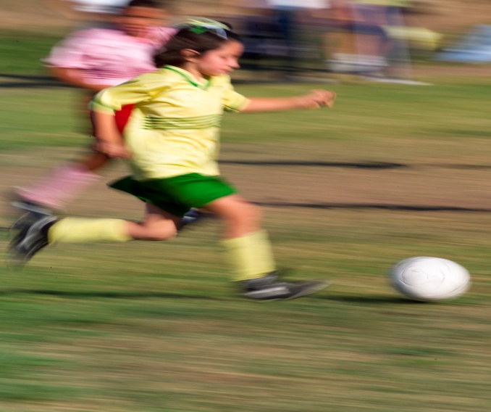
F. FIRST LAW OF MOTION
An object at rest tends to stay at rest, an object in motion tends to stay in motion until an outside force acts on it—law of inertia
Inertia—tendency of an object to resist a change in motion
Objects on earth slow down or stop because of the outside force of friction

Slide 8
G. SECOND LAW OF MOTION
Force=mass X acceleration—explains how an unbalanced force changes the motion of objects
Unbalanced force—force without an equal force in the opposite direction

Slide 9
when an unbalanced force acts on an object, changes its velocity
Acceleration—rate of change in velocity—greater force, greater acceleration; greater the mass, smaller the acceleration

Slide 10
H. THIRD LAW OF MOTION
For every action force, there is an equal and opposite reaction force.
Forces of action and reaction are always equal

